Slide 1
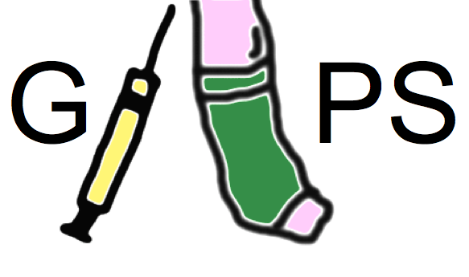
GAPS:
a study to determine the need for stockings to prevent blood clots
Chief Investigator: Prof. Alun Davies
Graduated compression as an Adjunct to Pharmacoprophylaxis in Surgery

Slide 2
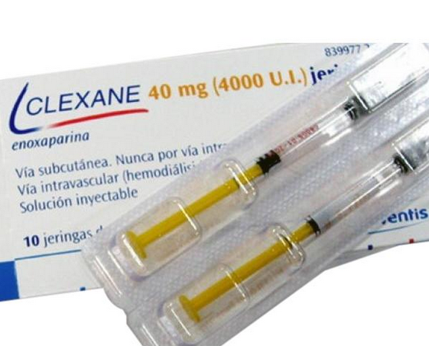
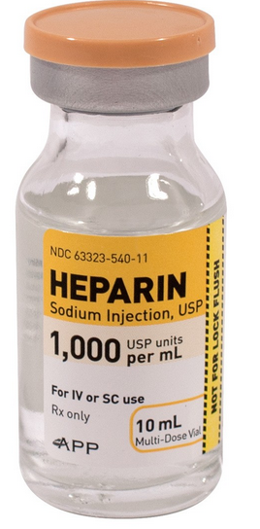
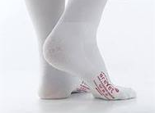
All surgical patients at medium or high risk for
Deep Vein Thrombosis (DVT) or pulmonary embolism (PE)
should receive both:
Blood thinners
Compression stockings (e.g.TEDs)
New evidence suggests compression stockings do not offer any benefit in addition to using blood thinners.

Slide 3
GAPS is a research study
to see if there is any benefit for patients to wear compression stockings
to prevent DVT
when undergoing surgery

Slide 4
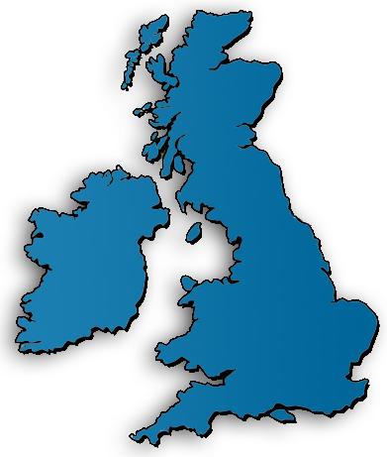
GAPS is looking to recruit 2236 patients over 18 months from 7 hospitals
Heart of England NHS Foundation Trust
Cambridge University Hospitals NHS Foundation Trust
University Hospital Southampton NHS Foundation Trust
Guy’s and St Thomas’ NHS Foundation Trust
Salisbury NHS Foundation Trust
Imperial College Healthcare NHS Trust
Portsmouth NHS Trust

Slide 5
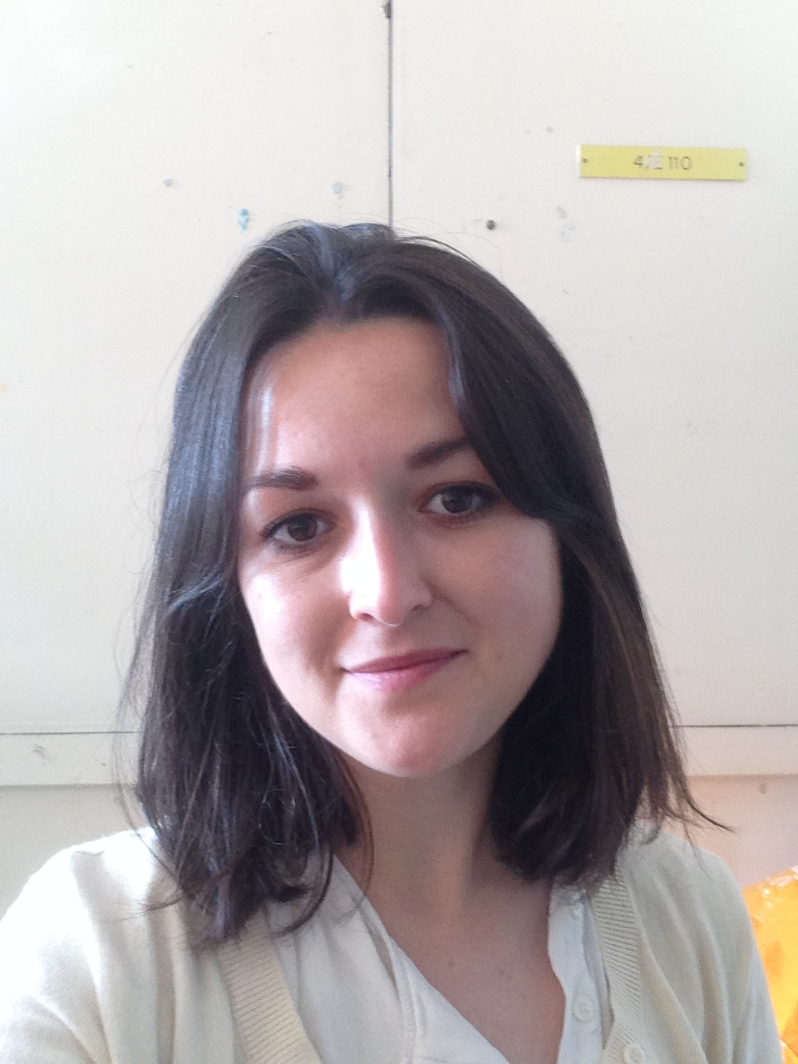
For more information contact:
GAPS Research nurse:
Vernisha Ali
Tel: 0203 311 7304
Email: vernisha.ali@imperial.nhs.uk
GAPS Trial Managers:
Rebecca Lawton Francine Heatley
Tel: 0203 311 5204 Tel: 0203 311 7371
Email: gapstrial@imperial.ac.uk

